Slide 1
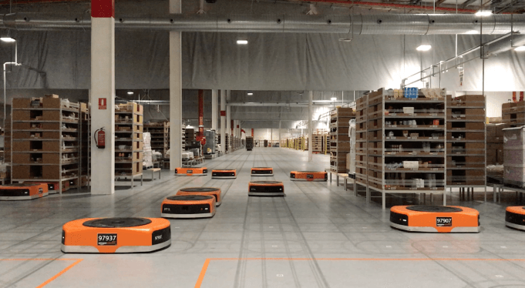
Amazon Robotics machines in a Amazon warehouse
Collision avoidance for multiple robots
Luca Marseglia

Slide 2
Summary
Introduction to the previous work and experiments
Trajectory planning: First approach with Spline + Uniform acceleration
Trajectory planning: New approach with Cubic Hermite Polynomia (PCHIP) and Smooth velocity profile
Collision avoidance: First approach
Collision avoidance: Prioritized approach
Future work
2024 August | Slide 2

Slide 3
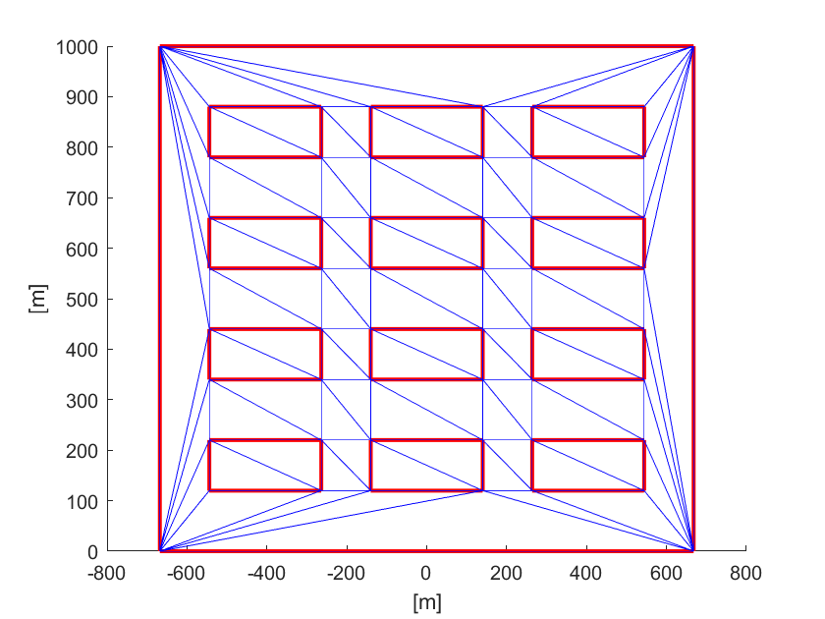
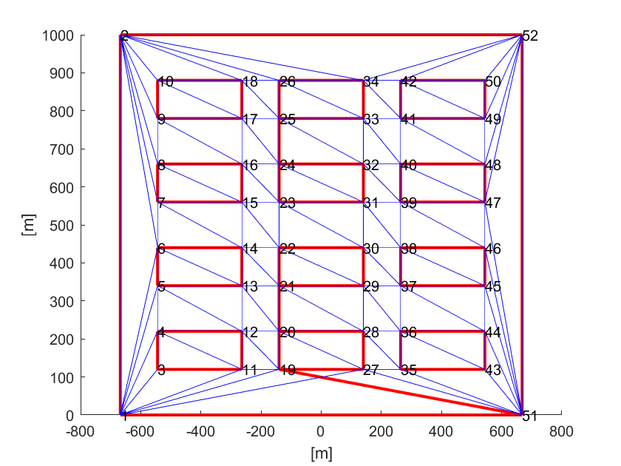
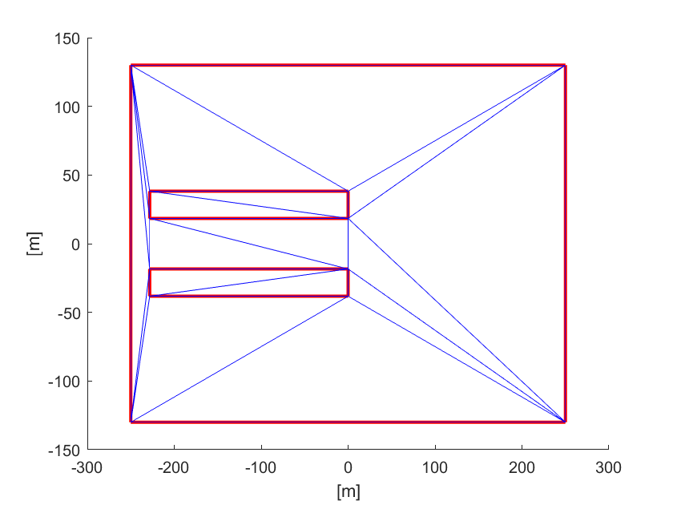
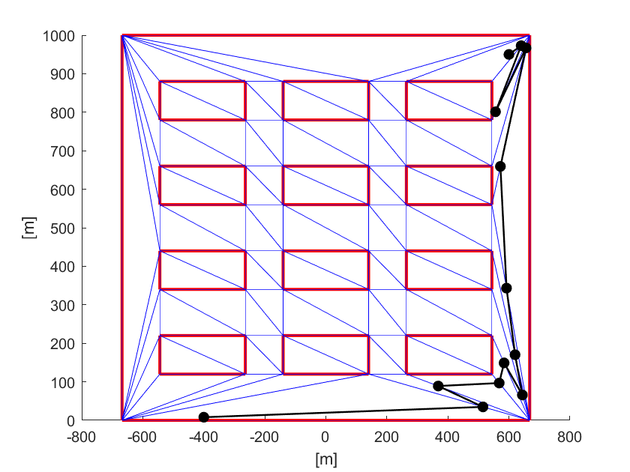
Understanding triangulation
The first steps consisted in understanding the previous work, with some experiments performed with different maps.
Triangulation
Map modification
Path generation
and plotting
Creation of
new maps
2024 August | Slide 3

Slide 4
Goal
The DT-RRT* algorithm from the previous work produces an optimized path from a starting point to the goal point.
The algorithm can also be employed to produce different paths for a fleet of trolleys.
Starting from the paths produced by the DT-RRT*, the current goal is the development of a trajectory planning algorithm for the formation of a fleet of trolleys and an algorithm for collision avoidance optimization.
2024 August | Slide 4

Slide 5
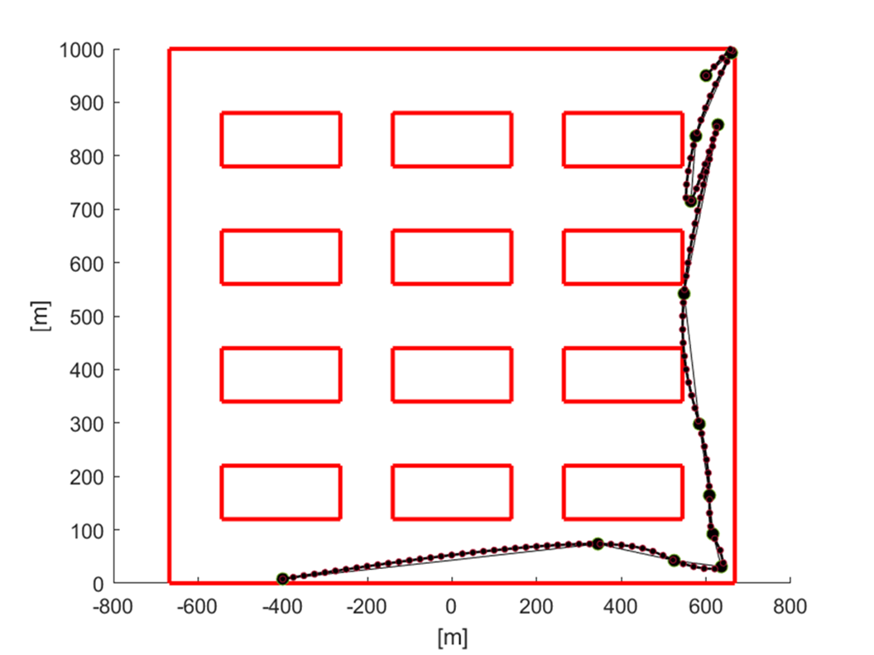
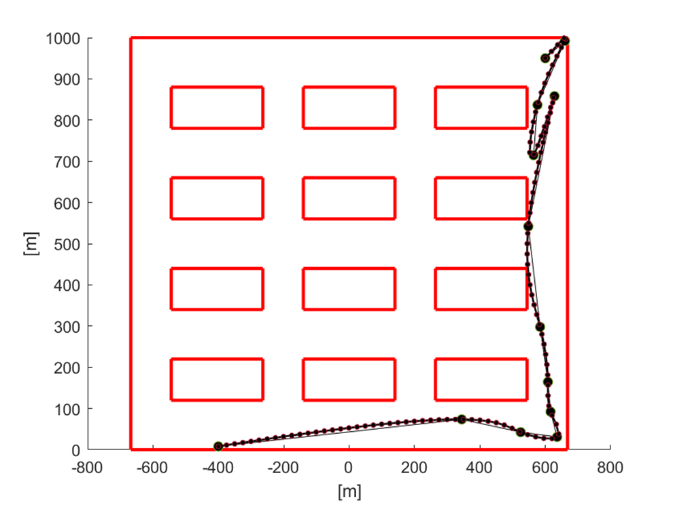
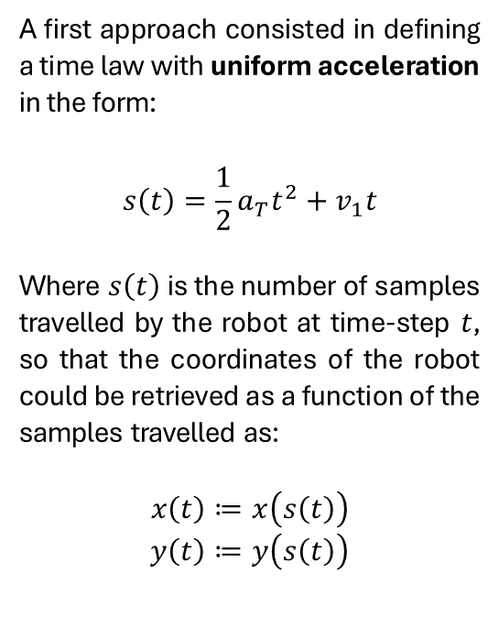
First approach
The points computed by the DT-RRT* (bigger dots on the plot) have been interpolated (smaller dots).
The core idea behind the path planning step is to create a velocity law for the whole interpolated path.
A possible algorithm should take a maximum travel velocity for the robot in input and return the coordinates of the robot along the trajectory over time.
A first approach consisted in defining a time law with uniform acceleration in the form:
$$s\left(t\right)=\frac{1}{2}a_{T}t^{2}+v_{1}t$$
Where $s\left(t\right)$ is the number of samples travelled by the robot at time-step $t$, so that the coordinates of the robot could be retrieved as a function of the samples travelled as:
$$x\left(t\right)≔x\left(s\left(t\right)\right)$$
$$y\left(t\right)≔y\left(s\left(t\right)\right)$$
time
2024 August | Slide 5

Slide 6
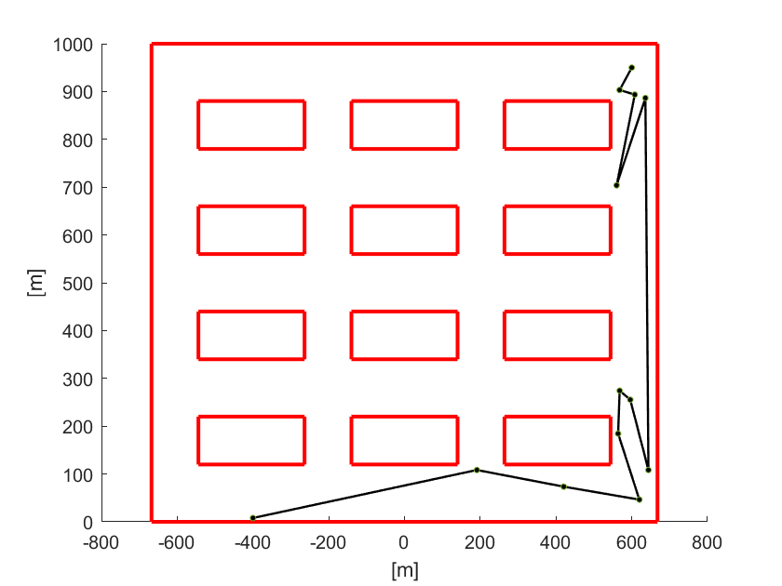
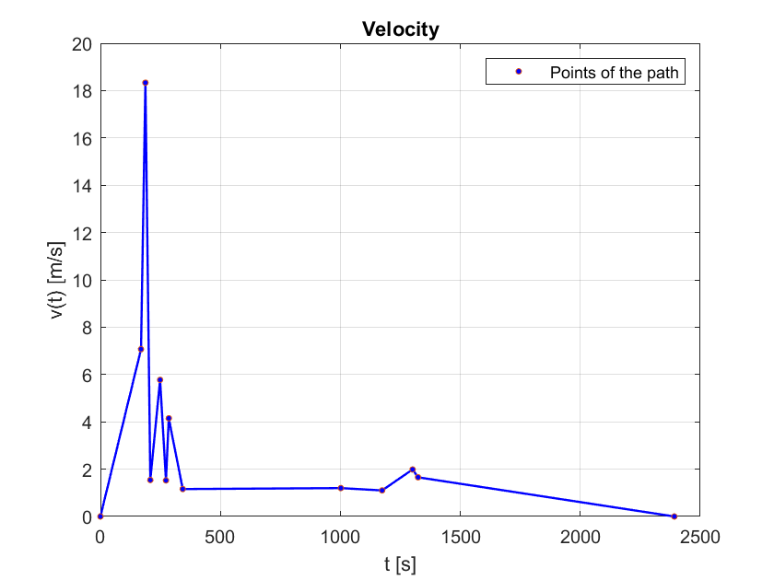
Velocity profile
The following plots show the behavior with the defined velocity law, where the robot travels with uniform acceleration along each segment of the path.
2024 August | Slide 6

Slide 7
August
Before taking any further step, some adjustments and improvements to the work of July had to be made:
Development of the code for animating the trajectories
Variation of the Velocity law (New approach)
Simplification and slight optimization of the code
Animating the trajectories helped to understand that the velocity law should have been improved.
Besides the previous steps, the work of August consisted in building an algorithm for collision avoidance.
2024 August | Slide 7

Slide 8
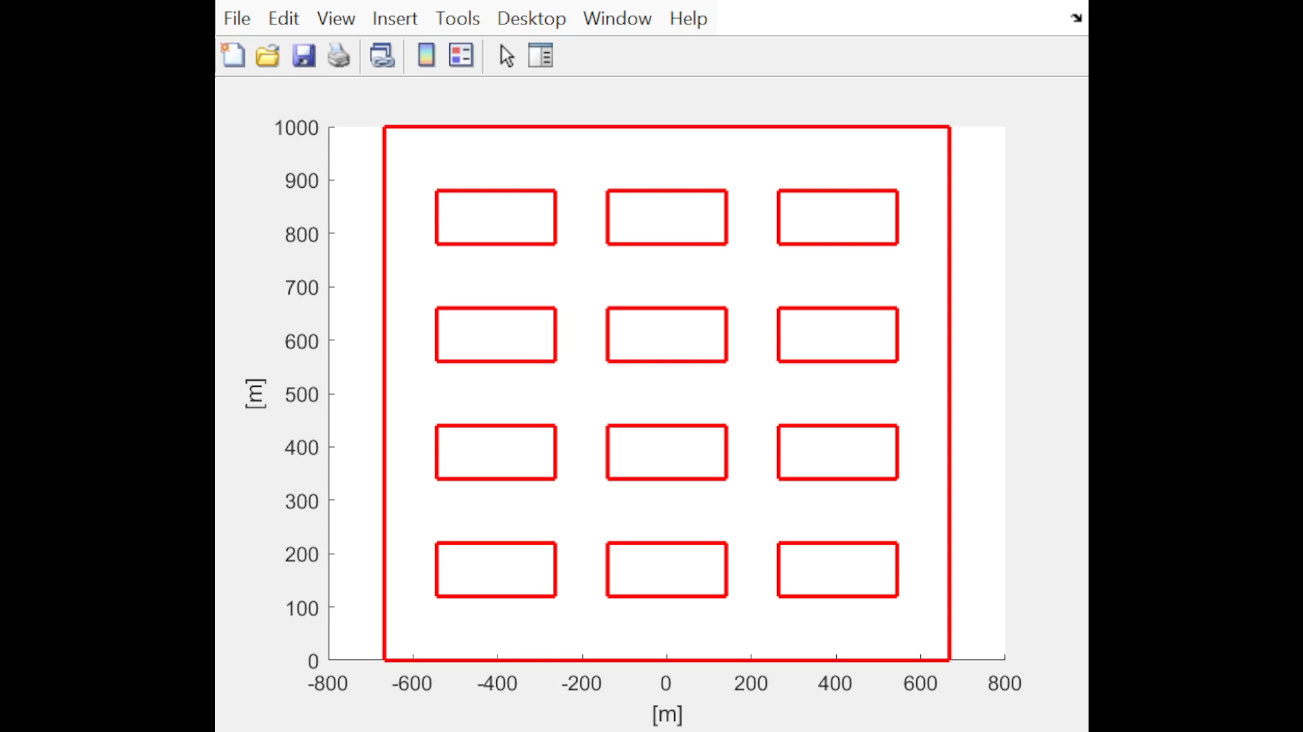
Animating the trajectories: Old approach
2024 August | Slide 8

Slide 9
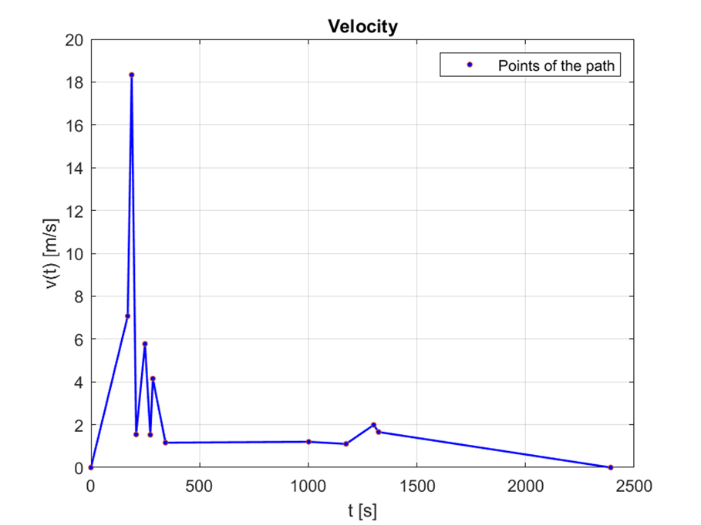
New approach
The new approach uses the Piecewise Cubic Hermite Interpolating Polynomial (PCHIP) method instead of the former one.
Besides, the velocity profile does not include uniform acceleration anymore.
2024 August | Slide 9

Slide 10
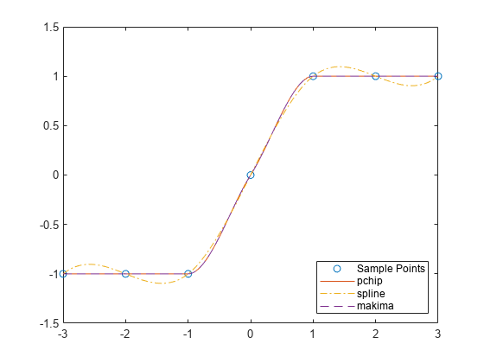
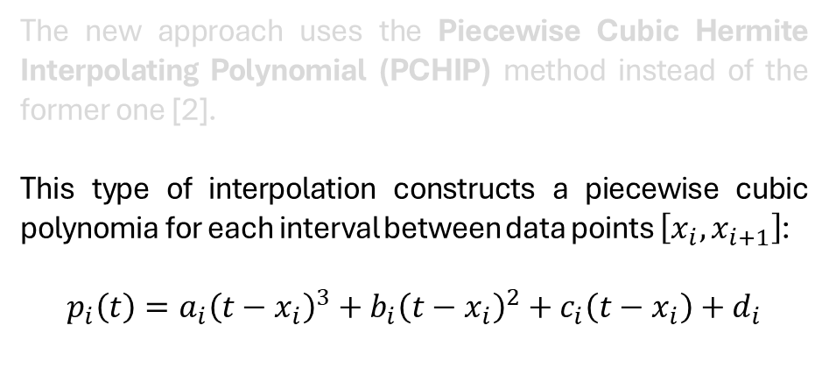
New approach
The new approach uses the Piecewise Cubic Hermite Interpolating Polynomial (PCHIP) method instead of the former one [2].
This type of interpolation constructs a piecewise cubic polynomia for each interval between data points $\left[x_{i},x_{i+1}\right]$:
$$p_{i}\left(t\right)=a_{i}{\left(t−x_{i}\right)}^{3}+b_{i}{\left(t−x_{i}\right)}^{2}+c_{i}\left(t−x_{i}\right)+d_{i}$$
2024 August | Slide 10

Slide 11
New approach: advantages
With this new approach, the trajectories have a more natural behavior both in terms of velocity and the geometry of the interpolated path.
The velocity profile has a smoother behavior between two adjacent segments, and so the robot does not experience abrupt and sudden accelerations anymore
The interpolation of the path preserves its shape, without overshoots with respect to its geometry
2024 August | Slide 11

Slide 12
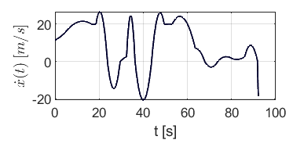
New approach: advantages
With this new approach, the trajectories have a more natural behavior both in terms of velocity and the geometry of the interpolated path.
The velocity profile has a smoother behavior between two adjacent segments, and so the robot does not experience abrupt and sudden accelerations anymore
The interpolation of the path preserves its shape, without overshoots with respect to its geometry
Old approach (uniform acceleration)
New approach (Pchip interpolation)
2024 August | Slide 12

Slide 13
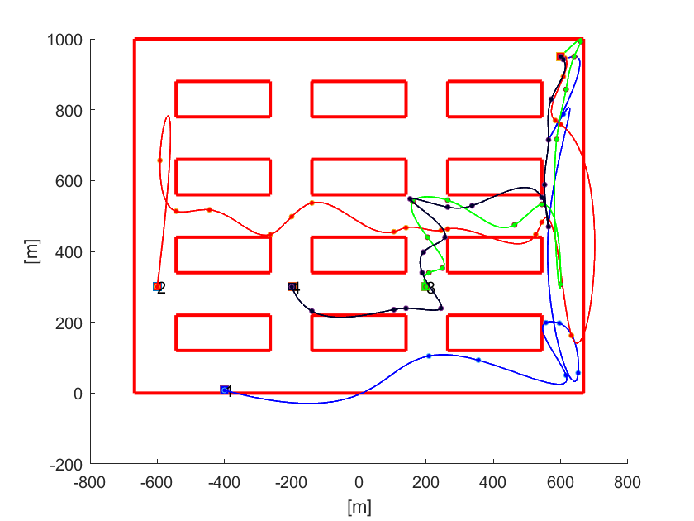
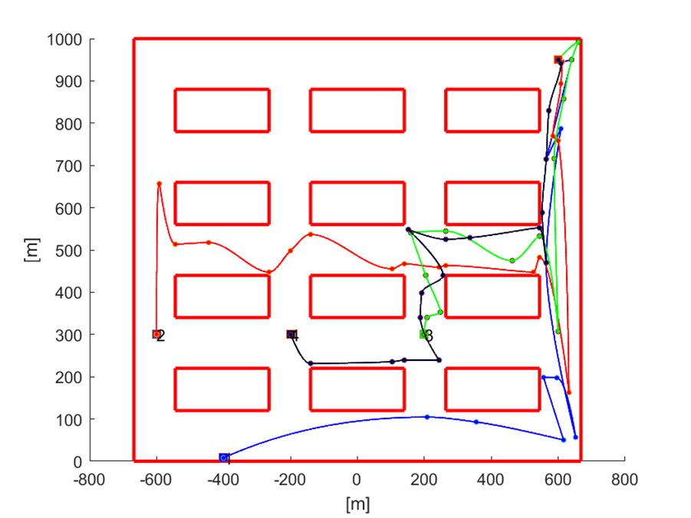
New approach: advantages
With this new approach, the trajectories have a more natural behavior both in terms of velocity and the geometry of the interpolated path.
The velocity profile has a smoother behavior between two adjacent segments, and so the robot does not experience abrupt and sudden accelerations anymore
The interpolation of the path preserves its shape, without overshoots with respect to its geometry
Old approach (Spline interpolation)
New approach (Pchip interpolation)
2024 August | Slide 13

Slide 14
New approach
2024 August | Slide 14

Slide 15
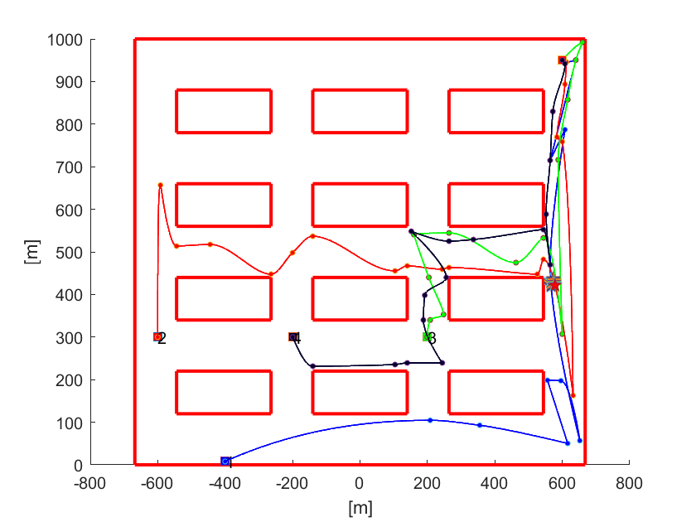
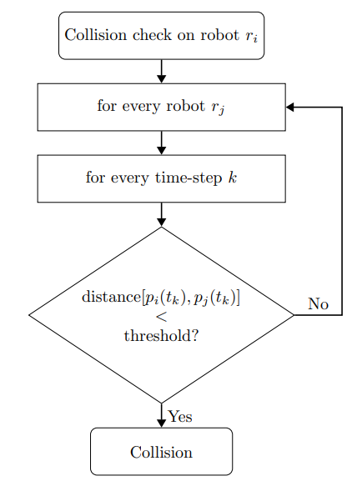
Collisions checking
2024 August | Slide 15

Slide 16
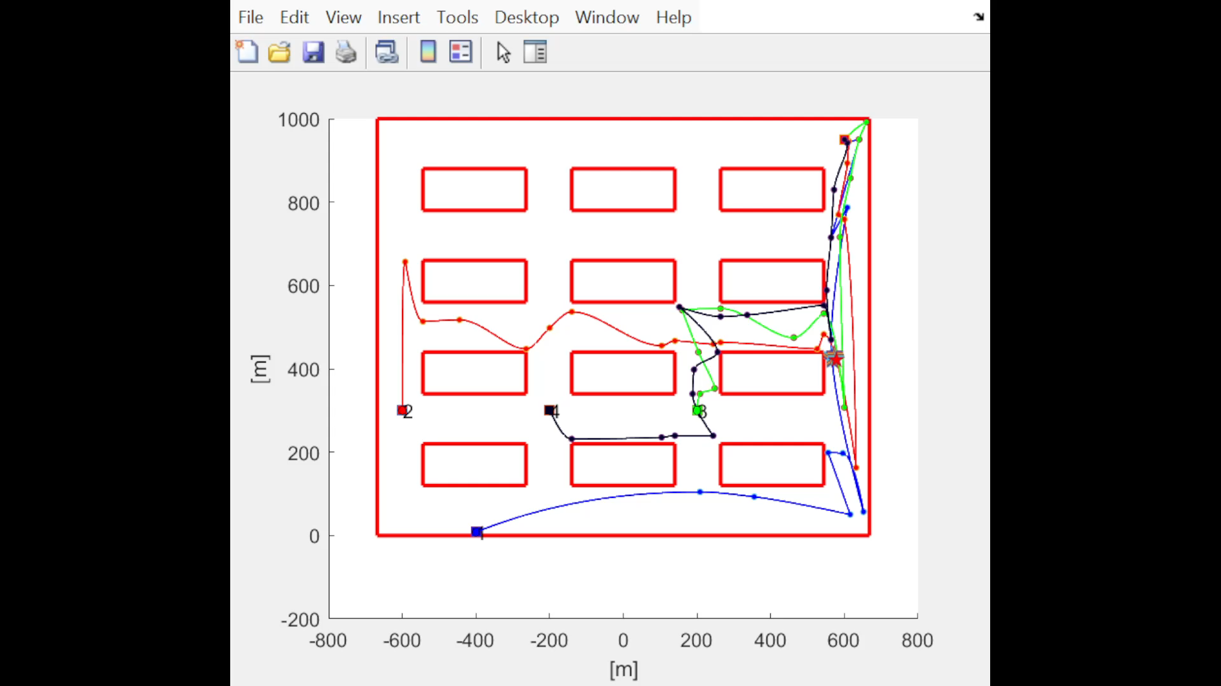
Collisions checking
2024 August | Slide 16

Slide 17
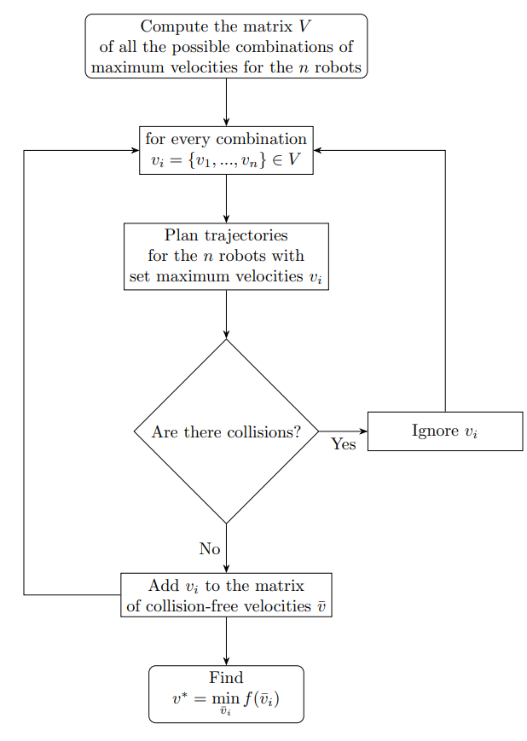
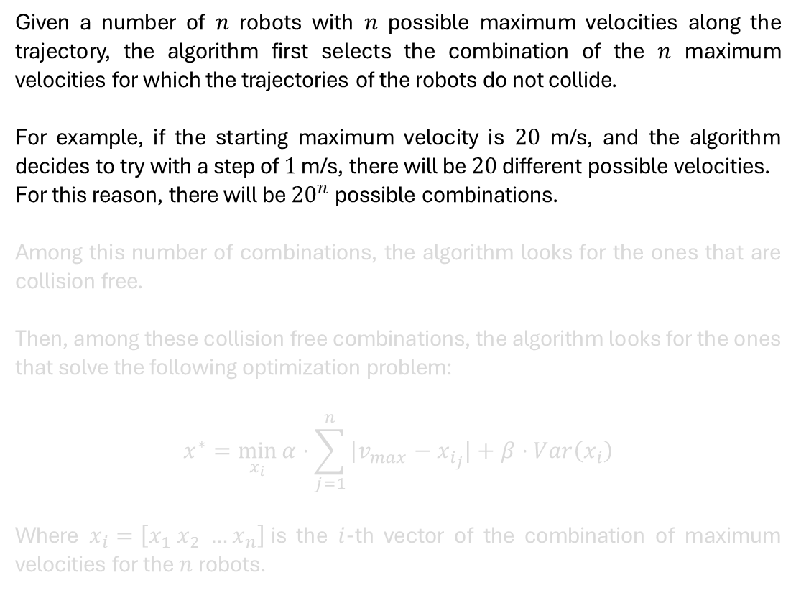
Collisions avoidance: First approach
Given a number of $n$ robots with $n$ possible maximum velocities along the trajectory, the algorithm first selects the combination of the $n$ maximum velocities for which the trajectories of the robots do not collide.
For example, if the starting maximum velocity is $20$ m/s, and the algorithm decides to try with a step of $1$ m/s, there will be $20$ different possible velocities.
For this reason, there will be ${20}^{n}$ possible combinations.
Among this number of combinations, the algorithm looks for the ones that are collision free.
Then, among these collision free combinations, the algorithm looks for the ones that solve the following optimization problem:
$$x^{∗}=\min_{x_{i}}{α⋅\sum_{j=1}^{n}{|v_{max}−x_{i_{j}}|}+β⋅Var\left(x_{i}\right)}$$
Where $x_{i}=\left[x_{1} x_{2} …x_{n}\right]$is the $i$-th vector of the combination of maximum velocities for the$n$robots.
2024 August | Slide 17

Slide 18
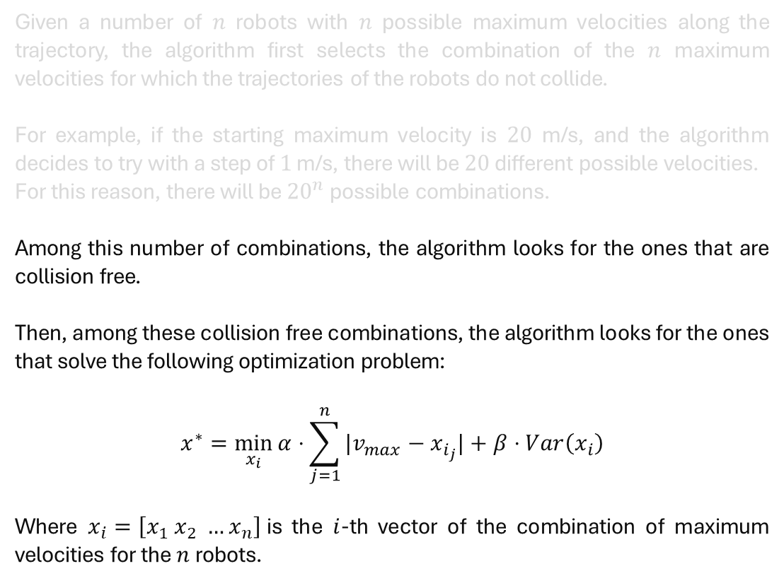
Collisions avoidance: First approach
Given a number of $n$ robots with $n$ possible maximum velocities along the trajectory, the algorithm first selects the combination of the $n$ maximum velocities for which the trajectories of the robots do not collide.
For example, if the starting maximum velocity is $20$ m/s, and the algorithm decides to try with a step of $1$ m/s, there will be $20$ different possible velocities.
For this reason, there will be ${20}^{n}$ possible combinations.
Among this number of combinations, the algorithm looks for the ones that are collision free.
Then, among these collision free combinations, the algorithm looks for the ones that solve the following optimization problem:
$$x^{∗}=\min_{x_{i}}{α⋅\sum_{j=1}^{n}{|v_{max}−x_{i_{j}}|}+β⋅Var\left(x_{i}\right)}$$
Where $x_{i}=\left[x_{1} x_{2} …x_{n}\right]$is the $i$-th vector of the combination of maximum velocities for the$n$robots.
2024 August | Slide 18

Slide 19
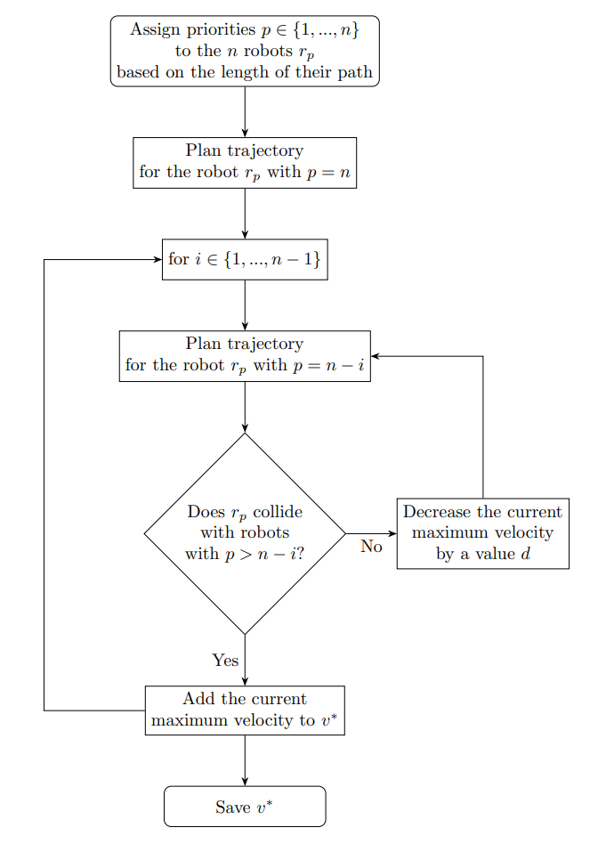
Collisions avoidance: Prioritized approach
The idea of checking all possible combinations can make the execution slow. For example, when passing from 4 to 7 robots, the execution time can increase from the order of the minutes to the order of the hours.
For this reasons, considerations for more efficient methods can be performed.
A possible approach is Prioritized Planning, proposed in [4].
In a Prioritized approach, each of the robots is assigned a priority. Then in order of decreasing priority, the robots are picked. For each picked robot a trajectory is planned, avoiding collisions with the previously picked robots, which are considered as dynamic obstacles
2024 August | Slide 19

Slide 20
Collisions avoidance: Prioritized approach
The idea of checking all possible combinations can make the execution slow. For example, when passing from 4 to 7 robots, the execution time can increase from the order of the minutes to the order of the hours.
For this reasons, considerations for more efficient methods can be performed.
A possible approach is Prioritized Planning, proposed in [4].
In a Prioritized approach, each of the robots is assigned a priority. Then in order of decreasing priority, the robots are picked. For each picked robot a trajectory is planned, avoiding collisions with the previously picked robots, which are considered as dynamic obstacles
2024 August | Slide 20

Slide 21
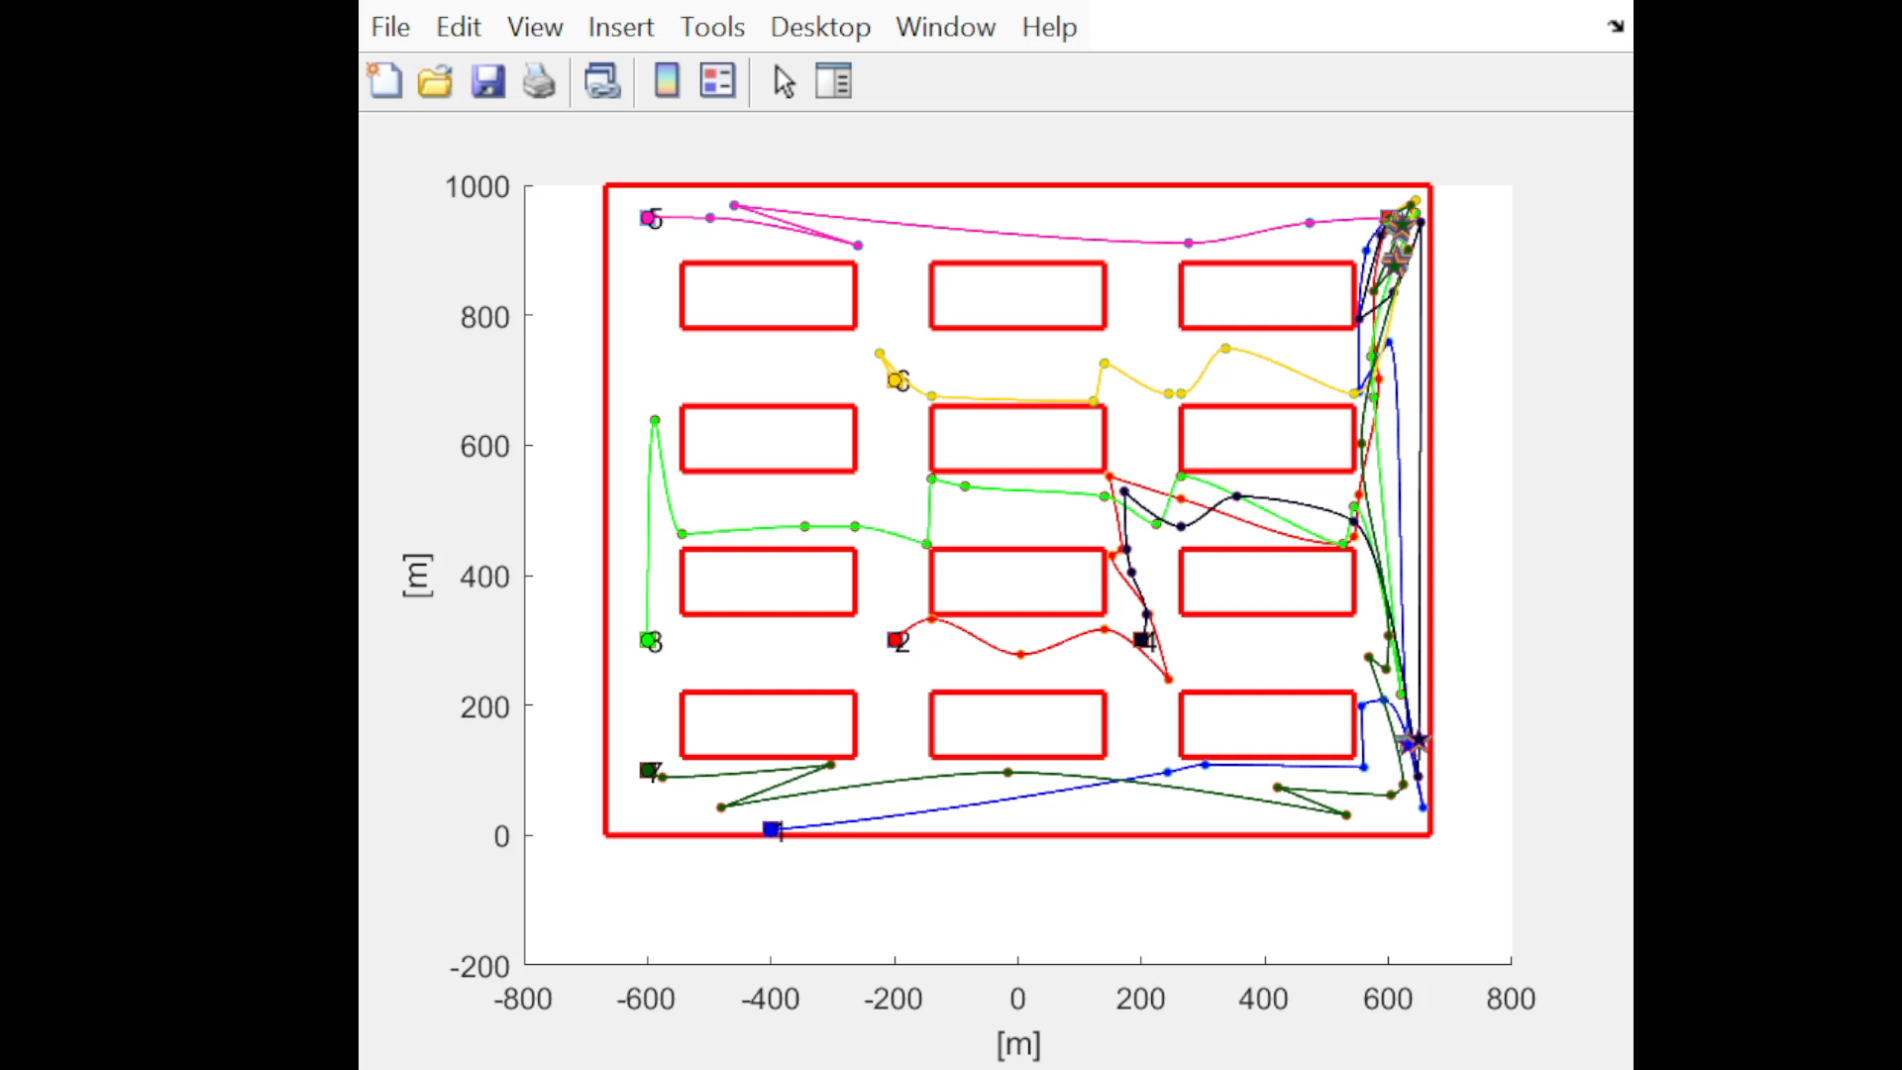
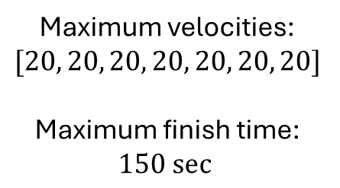
Collisions avoidance: Prioritized approach
Maximum velocities:
$$[20, 20, 20, 20, 20, 20, 20]$$
Maximum finish time:
$$150 sec⁡$$
Collision
2024 August | Slide 21

Slide 22
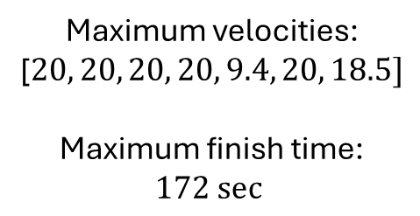
Collisions avoidance: Prioritized approach
Maximum velocities:
[$20, 20, 20, 20, 9.4, 20, 18.5]$
Maximum finish time:
$$172 sec⁡$$
No collision
2024 August | Slide 22

Slide 23
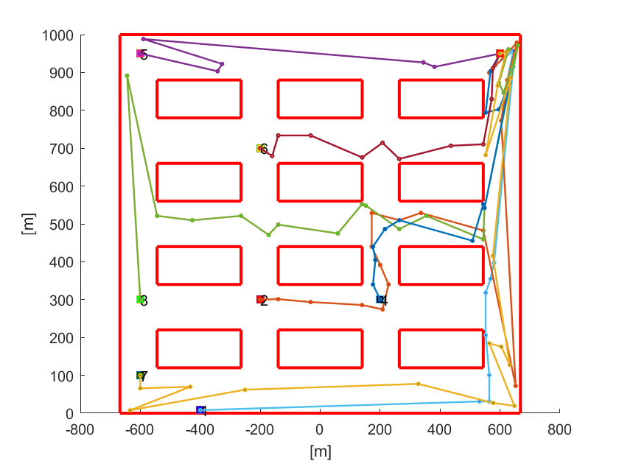
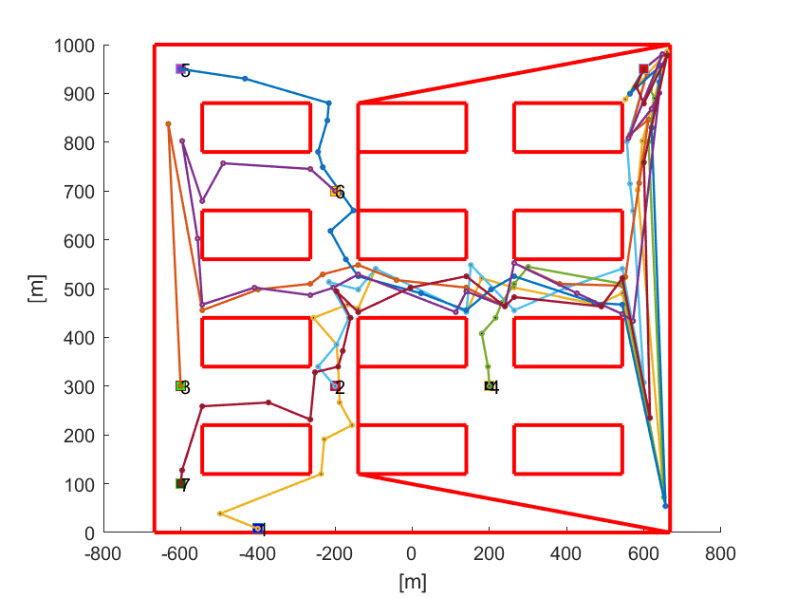
Future work
Start working on the algorithm involving the addition on virtual obstacles to the map to create a common path
Update on Gonçalo’s work
2024 August | Slide 23

